Slide 1
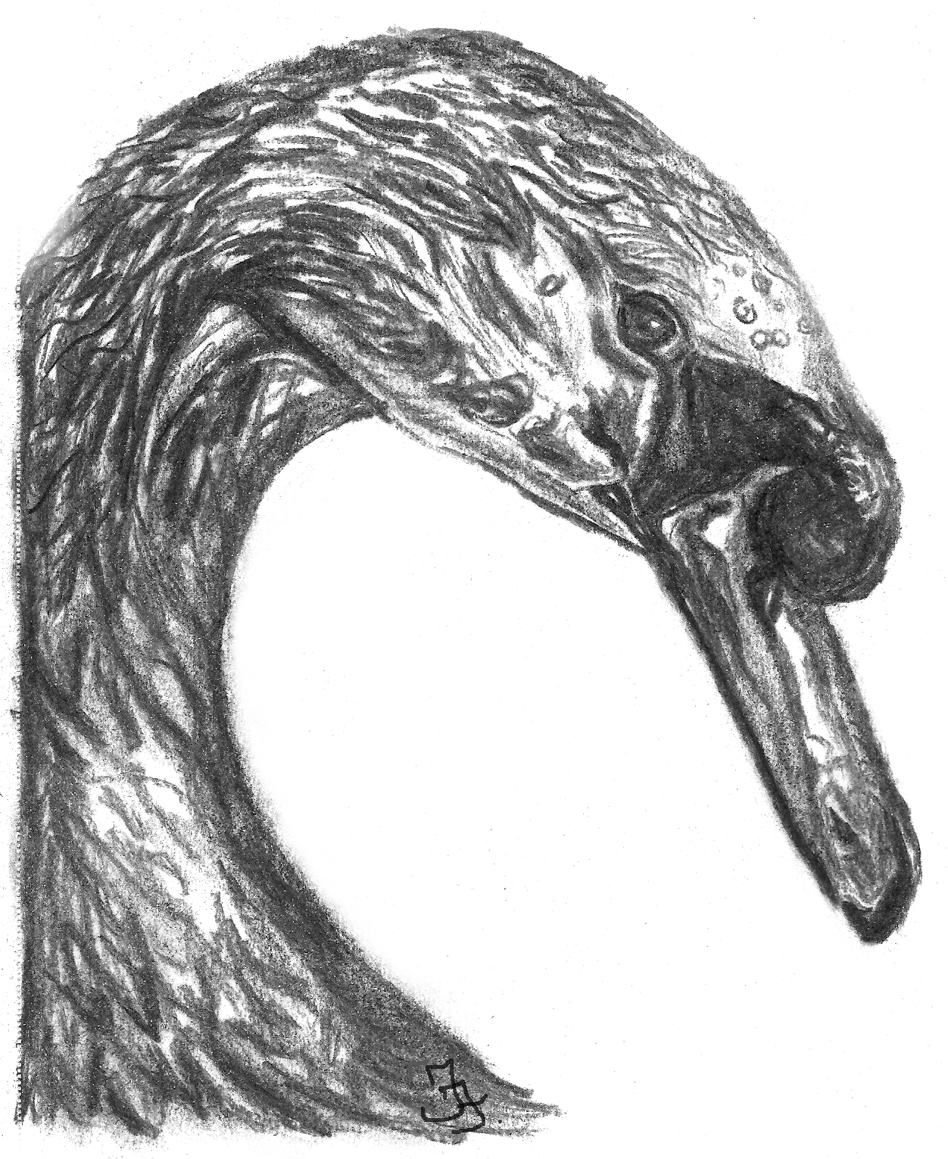
Shipston Music Society, Shipston on Stour Methodist Church
February 18th
2022 at 7:30pm
Music by
Fiona T Frank
(“Mystical Swan in
Blue”) & Schubert
(“Schwanengesang”
. -transcription by Liszt)
performed by
Charles Matthews
www.charlesmatthews.co.uk
www.Fiona-Frank.com

