Slide 1
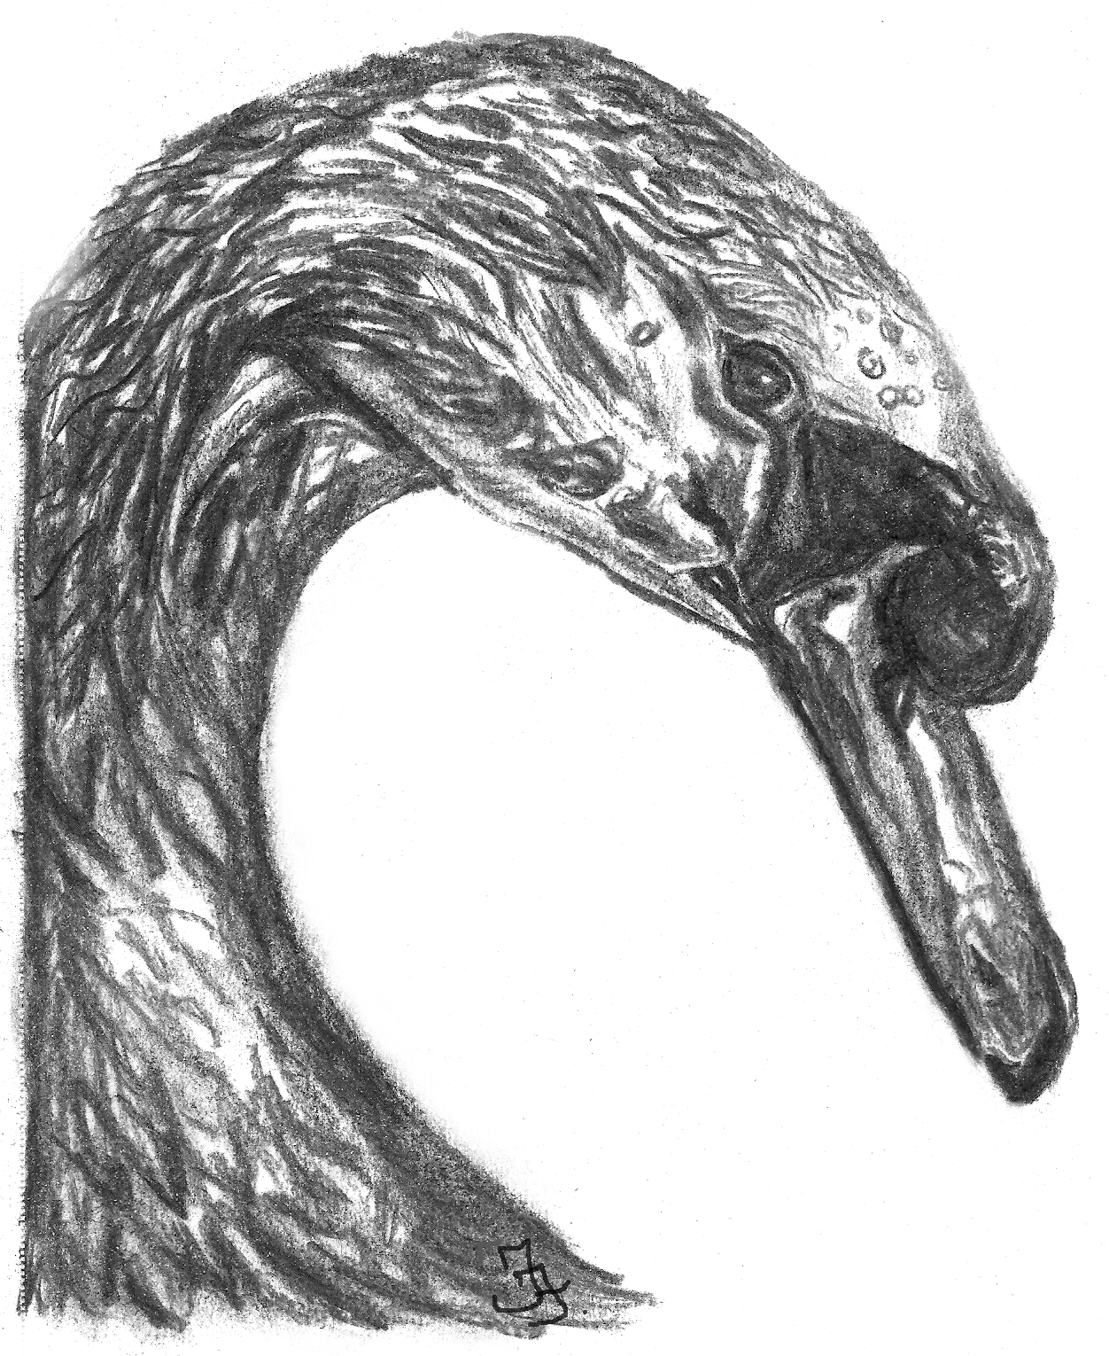
Lunchtime concert at
St Andrew’s Parish Church, Rugby
Music by
Fiona T Frank
World premiere of
“Mystical Swan in Blue”
& E. J. Moeran
performed by
Charles Matthews
February 8th
2022 at 1pm
www.charlesmatthews.co.uk www.Fiona-Frank.com

